Slide 1

5. Mailserver-Konferenz 2011
QR:
Mark Martinec
Institut “Jožef Stefan”, Slovenia
amavis.org/Z1
( pdf )
amavis (amavisd-new)
Configuration and Management
2.7.0 update
<Foliennummer>

Slide 2
Agenda
what it is, quick project history
some tuning hints
updates on a 2.7.0 release
pre-queue (proxy) filtering
configuration: policy banks, lookups, cc
monitoring
<Foliennummer>

Slide 3
Amavis - what is it?
interface between MTA and
virus checkers and/or spam checkers
like spamd for SA, but speaks standard SMTP
checks for banned content and header syntax
quarantining/archiving
DKIM: signs and verifies signatures
monitoring: SNMP, SQL log, nanny
3

Slide 4
why is it popular?
reliable:
  checks status of every operation, internal asserts
  in case of a failure mail stays with MTA, not lost
adheres to standards (SMTP, MIME, DSN, ...)
reasonably fast, feature-rich
maintainable: logging for troubleshooting
security: perl, taint checks, can run chroot-ed
mature: 9+ years of steady development
OSS: GPL 2 license (+ BSD licensed tools)
4

Slide 5
AMaViS – A Mail Virus Scanner
shell program:
1997 Mogens Kjaer, Juergen Quade
1998 .. 2000 AMaViS Christian Bricart, Rainer Link, Chris Mason
( amavis.org )
Perl program:
2000-01 Amavis-perl Chris Mason
2003-03 Amavis-0.3.12 Lars Hecking
Perl daemon:
2001-01 .. 2003-03 amavisd Geoff Winkless, Lars Hecking
Perl, re-design
2002-03 .. 2003-03 amavis-ng Hilko Bengen
5

Slide 6
Amavis releases and events ...
2002-03-29 amavisd-new, pre-forked, Net::Server
2004-07-01 2.0 policy banks, IPv6 address formats
2005-04-24 2.3.0 @decoders, per-recip banning rules
2006-04-02 2.4.0 DSN in SMTP, %*_by_ccat
2007-04-23 2.5.0 blocking cc, new SMTP client
2008-01-13 SpamAssassin Project Mgmt Committee
2008-04-23 2.6.0 DKIM, bounce killer, TLS
2009-06-25 2.6.4 SNMP monitoring
6

Slide 7
... Amavis releases and events
2010-04-25 2.7.0-pre4
2011-02-03 2.7.0-pre14
2011-03-07 moved ML from SF to amavis.org
(hosted by Patrick Ben Koetter and Ralf Hildebrandt)
2011-04-07 2.6.5
2011-05-19 2.6.6
2011-05-18 2.7.0-rc1
9+ years of steady
amavisd-new development
7

Slide 8
Did it grow too large?
29.000 lines of Perl code (with comments)
modules, loaded only what is needed
half of memory footprint is SpamAssassin
memory is not a limitation to mail size
grows linearly, hardware exponentially
7

Slide 9
Is it slow?
written in Perl
perform operations on large chunks of data
avoid line-by-line processing
avoid copying data
critical code paths are well optimized
sanity limits and suitable data struct & alg
the slow part is SpamAssassin, if enabled
9

Slide 10
2.7.0
SMTP read speedup example
by a factor of 3.9 (non-TLS) – 32.3 MiB/s
by a factor of 11 for TLS
The bottleneck was line-by-line reading due to SMTP dot-destuffing. Code reworked to operate on entire buffers, dealing with dot-stuffing intricacies when crossing buffer boundaries.
9

Slide 11
Network latency in SA a problem?
DNS black and white lists (RBL)
DCC, Razor, Pyzor network services
The bottleneck in SpamAssassin is CPU,
idle wait times are compensated by running
more processes, the only cost is memory.
9

Slide 12
Performance – parallelism
msgs/s vs. maxproc
95%
best maxproc
9

Slide 13
Performance: SpamAssassin
msgs/s vs. maxproc
virus checks only
spam + virus checks
9

Slide 14
Some tuning hints
choose number of processes to match CPU capacity
avoid slow command-line virus scanners
Linux syslogd: disable sync on MTA/amavisd logs
turn on $quarantine_subdir_levels = 1
examine timing reports at $log_level = 2
observe nanny, $nanny_details_level = 2
separate disks for MTA spool and amavisd tmp
separate MTA and amavisd hosts
split load through multiple MX records
14

Slide 15
SpamAssassin tuning ideas
use SQL for r/w Bayes and AWL databases
alternatively: r/o cdb, updated offline
compiled rules: sa-compile
limit mail size, truncate since 2.6.3 / SA 3.3.0
avoid slow regexp rules (HitFrequencies.pm)
reduce time limits on rbl, razor, pyzor
use local caching DNS server, mirrored RBL
examine SA timing reports at log level 2
15

Slide 16
2.7.0
New in 2.7.0 – at a glance
improved as a pre-queue proxy content filter
per-recipient SpamAssassin Bayes & user prefs
external DKIM signer
next hop failover
new macros, more informative logging
SMTP/LMTP receive speedup
Sophos-SSSP, Avira SAVAPI, clamd streaming
...
16

Slide 17
2.7.0
pre-queue filtering
Benefits:
can reject original SMTP session
(eliminates bounce backscatter to 3rd parties)
preferred to quarantine & discard or tag & deliver
Drawbacks:
tighter timing constraints
no. of content filters is more tightly coupled
to a number of concurrent SMTP sessions
must cope with peaks, instead of averages
17

Slide 18
2.7.0
pre-queue filter requirements
real-time nature
no. of filters = no. of sessions (almost)
SMTP end-of-data timeout at a mercy of client
minimize disruption caused by a filter restart
17

Slide 19
2.7.0
Stricter time limits
reworked sub-task time limiting
needs SpamAssassin 3.3.0 or later: master_deadline, results despite aborted tests
$child_timeout = 45 (good starting point)
the longest time most SMTP clients are willing to wait, less than smtpd_proxy_timeout (100 s)
19

Slide 20
2.7.0
Warm/flying reload
amavisd reload signals a HUP to a daemon
daemon clears FD_CLOEXEC on socket fd
and stores socket info to BOUND_SOCKETS
daemon restarts itself by exec(), passing
open socket descriptors to next incarnation
new instance attaches sockets to inherited fd
20

Slide 21
pre-queue filtering – Postfix
new option – since Postfix 2.7.0 (20091101) :
smtpd_proxy_options = speed_adjust
Postfix SMTP server receives an entire message
before connecting to a before-queue (proxy)
content filter
decouples slow SMTP clients from content filters
21

Slide 22
pre-queue filtering – Postfix
postscreen(8) is a new Postfix 2.8 feature, reducing the load on pre-queue content filters:
smtp inet n - n - 1 postscreen
smtpd pass - - n - 150 smtpd
-o smtpd_proxy_filter=inet:[127.0.0.1]:10010
-o smtpd_proxy_options=speed_adjust
22

Slide 23
2.7.0
External DKIM signer
amavisd calls Mail::DKIM to pre-process a message for signing
sends a prepared DKIM mail digest to an external signing daemon, along with a signing domain name and a selector (d, s)
receives a signed digest (p) and inserts a signature header field into a message
private keys can be kept hidden from amavisd
22

Slide 24
Penpals
old but often neglected feature
to reduce false positives
Our.Alice@here –> Some.Bob@example
Some.Bob@example –> Our.Alice@here
also: Message-ID <–> In-Reply-To, References
22

Slide 25
Bounce killer
another old but often neglected feature
to reduce foreign backscatter
If a message looks like a bounce and contains a header section of original mail, check if that came from our server. If decisively not, drop it.
22

Slide 26
Configuration – agenda
general
mail flow direction
logging, syslog
interfacing: input, output, milter
policy banks
lookups
content categories
22

Slide 27
Configuration – general
all config settings: amavisd.conf-default
directories, hostname, ...
user (uid)
destination, source
$max_servers
$nanny_details_level = 2; # verbosity: 0, 1, 2
22

Slide 28
Configuration – mail flow direction
origin: @mynetworks, $originating
destination: @local_domains_maps
originating (property of a message)
local-recipient (property of a recipient)
0 0 ... open relay
0 1 ... inbound
1 0 ... outbound
1 1 ... internal-to-internal
28

Slide 29
Configuration – destination
list all your domains in @local_domains_maps
(local, virtual aliases, virtual mailbox, relay)
affects:
inserting header fields X-Spam-*,
X-Quarantine-ID, X-Amavis-OS-Fingerprint, ...
adding address extension (plus addressing)
recipient notifications
pen pals
defanging
statistics / SNMP
29

Slide 30
Configuration – origin (source)
origin: @mynetworks, $originating
affects:
DKIM signing
inserting disclaimers
bounce killer
pen pals
MYUSERS policy bank
statistics / SNMP
30

Slide 31
Configuration – origin (source)
setting the $originating flag:
implicitly: @mynetworks
explicitly, typically through a policy bank:
$inet_socket_port = [10024, 10026];
$interface_policy{'10026'} = 'ORIG';
$policy_bank{‘ORIG'} = {
originating => 1,
};
31

Slide 32
2.7.0
Configuration – flow direction
2.7.0 new SQL fields:
msgs . originating
msgrcpt . is_local
see message flow direction from SQL log
32

Slide 33
2.7.0
Mail direction in SpamAssassin
internal_networks
trusted_networks
msa_networks
2.7.0: passes a value of the $originating flag to SpamAssassin 3.4.0, treated like msa_networks
33

Slide 34
Configuration – logging
SA amavisd syslog
-3 LOG_CRIT
-2 LOG_ERR
error -1 LOG_WARNING
warn 0 LOG_NOTICE
info 1 LOG_INFO
2 LOG_INFO
dbg 3 LOG_DEBUG
4 LOG_DEBUG
5 LOG_DEBUG
34

Slide 35
Configuration – syslog
$do_syslog = 1; (pre-2.7.0: $DO_SYSLOG)
$syslog_facility = 'user';
$log_level = 2; # verbosity 0..5
35

Slide 36
Configuration – /etc/syslog.conf
user.err; mail.crit; ... /var/log/messages
user.notice /var/log/amavisd.log
user.info /var/log/amavisd-info.log
user.debug /var/log/amavisd-debug.log
Prepend ' – ' to a filename on Linux
to disable sync!
36

Slide 37
Configuration – log template
$log_templ = <<'EOD';
[?%#D|#|Passed #
[...]
[? %q ||, quarantine: %q]#
[? %Q ||, Queue-ID: %Q]#
[? %m ||, Message-ID: %m]#
[? %r ||, Resent-Message-ID: %r]#
, mail_id: %i#
, Hits: [:SCORE]#
, size: %z#
[...]
EOD
37

Slide 38
Configuration – log template
$log_templ
$log_recip_templ
macros: README.customize
From, Subject, Message-Id, User-Agent,
size, Hits, Tests, banning, DKIM id, ...
38

Slide 39
2.7.0
Configuration – log template
two pre-defined log templates:
$log_templ = $log_short_templ; # default
$log_templ = $log_verbose_templ;
39

Slide 40
2.7.0
Configuration – log template
new macros:
client_helo, client_port, actions_performed,
mime2utf8, rusage, ...
40

Slide 41
2.7.0
Configuration – log template
new macro: actions_performed
action:
Accepted, Relayed, RelayedTagged, Discarded,
Rejected, Bounced, NoBounce, TempFailed
flow direction:
Inbound, Internal, Outbound, OpenRelay
41

Slide 42
2.7.0
Configuration – log template
new macro: actions_performed
examples:
Passed CLEAN {RelayedOutbound}, ...
Passed CLEAN {RelayedInbound}, ...
Passed CLEAN {RelayedInternal,RelayedOutbound},
Passed SPAMMY {RelayedTaggedInbound}, ...
Blocked SPAM {RejectedInbound,Quarantined}, ...
Blocked INFECTED (Mal/BredoZp-B) {DiscardedInbound,Quarantined}, ...
42

Slide 43
2.7.0
Configuration – logging
2.7.0: passing queue-id end-to-end (XFORWARD IDENT Postfix 2.8.0)
back-end MTA:
postfix/smtpd[72995]: 553261D1CB0: client=localhost[::1],
orig_queue_id=2F5971D1CA3, orig_client=...
post-queue content filter:
amavis[20341]: (20341-15) Passed CLEAN ...
Queue-ID: 2F5971D1CA3, queued_as: 553261D1CB0
front-end MTA:
postfix/lmtp[73130]: 2F5971D1CA3: ... relay=127.0.0.1[127.0.0.1]:10024,
status=sent (250 2.0.0 from MTA(smtp:[::1]:10025):
250 2.0.0 Ok: queued as 553261D1CB0)
43

Slide 44
Configuration – input interface
SMTP or LMTP or AM.PDP or AM.CL on input
$inet_socket_port = [10024, 10026, 10027];
# TCP port numbers
@inet_acl = qw( 127.0.0.0/8 [::1] 192.168.1.1 );
# access control
$inet_socket_bind = '127.0.0.1';
# restrict to one interface
$unix_socketname = '/var/amavis/amavisd.sock';
# quarantine release or milter
44

Slide 45
2.7.0
Configuration – input interface
2.7.0: a list @listen_sockets represents a
unified configuration of listening sockets.
Combined: $unix_socketname, $inet_socket_bind, $inet_socket_port
@listen_sockets = (10024, '*:10026',
'127.0.0.1:9998', '[::1]:9998', '192.0.2.0:10028',
"$helpers_home/amavisd.sock" )
45

Slide 46
Configuration – output
SMTP or LMTP or pipe on output
$forward_method = 'smtp:[127.0.0.1]:10025';
$notify_method = 'smtp:[127.0.0.1]:10025';
$forward_method = 'smtp:*:*';
$notify_method = 'smtp:*:10587';
1st asterisk use SMTP client peer address
2nd asterisk incoming SMTP/LMTP session port no. plus one
$virus_quarantine_method, $spam_quarantine_method, ...
46

Slide 47
2.7.0
Configuration – output
2.7.0: Failover or simpleminded load balancing
in SMTP and LMTP client – a list of next-hop destinations
Typical usage in $forward_method, $notify_method, $resend_method, $release_method, $requeue_method
$forward_method =
[ 'smtp:[::1]:10025', 'smtp:[127.0.0.1]:10025', 'smtp:*:10025' ];
$notify_method =
[ 'smtp:*:*', 'smtp:192.0.2.10:10025' ];
47

Slide 48
2.7.0
Configuration – output
by recipient:
@forward_method_maps
by contents category
%forward_method_maps_by_ccat
custom hook:
$msginfo->delivery_method( ... )
48

Slide 49
Configuration – milter setup
$unix_socketname =
'/var/amavis/amavisd.sock';
$interface_policy{'SOCK'} = 'SOMEMILTER';
$policy_bank{'SOMEMILTER'} = {
protocol => 'AM.PDP',
};
$forward_method = undef;
$notify_method = 'pipe: ... sendmail -Ac -i -odd
-f ${sender} -- ${recipient}';
49

Slide 50
Policy banks
one global, currently in effect,
set of configuration variables
several replacement sets (groups)
of configuration variables,
prepared in advance and on stand-by,
quickly loadable
affects message as a whole (not per-recipient)
50

Slide 51
Policy banks
$a = ”red”;
$b = 4;
$c = ”ABC”;
RED
current
$a = ”black”;
$b = 2;
$c = undef;
@d = (1, 2, 3);
$a = ”green”;
GREEN
$a = ”blue”;
$b = 99;
@d = (88);
BLUE
50

Slide 52
Policy banks
$a = ”red”;
$b = 4;
$c = ”ABC”;
RED
current
$a = ”blue”;
$b = 99;
$c = undef;
@d = (88);
$a = ”green”;
GREEN
$a = ”blue”;
$b = 99;
@d = (88);
BLUE
50
Notes:
<Foliennummer>

Slide 53
Policy banks
$a = ”red”;
$b = 4;
$c = ”ABC”;
RED
current
$a = ”green”;
$b = 99;
$c = undef;
@d = (88);
$a = ”green”;
GREEN
$a = ”blue”;
$b = 99;
@d = (88);
BLUE
50
Notes:
<Foliennummer>

Slide 54
Policy banks
$a = ”red”;
$b = 4;
$c = ”ABC”;
RED
current
$a = ”red”;
$b = 4;
$c = ”ABC”;
@d = (88);
$a = ”green”;
GREEN
$a = ”blue”;
$b = 99;
@d = (88);
BLUE
50
Notes:
<Foliennummer>

Slide 55
Policy banks – Perl syntax
normal settings
within a policy bank
variables, assignments
$a = ”xyz”;
@m = (1, 2, ”xyz”);
%h = (a => 1, b => 2);
separator: semicolon
list: (1, 2, 3)
hash: (a => 1, b => 2)
key / value pairs
a => ”xyz”,
m => [1, 2, ”xyz”],
h => { a => 1, b => 2 },
separator: comma
list reference: [1, 2, 3]
hash ref: { a => 1, b => 2 }
55

Slide 56
Policy banks – examples
$policy_bank{'NOVIRUSCHECK'} = {
bypass_decode_parts => 1,
bypass_virus_checks_maps => [1],
virus_lovers_maps => [1],
};
$policy_bank{'AM.PDP-SOCK'} = {
protocol => 'AM.PDP',
auth_required_release => 0,
syslog_ident => 'amavis-release',
};
56

Slide 57
Policy banks – example
$policy_bank{'ALT'} = {
originating => 1,
log_level => 2,
forward_method => 'smtp:*:*',
local_client_bind_address => '193.2.4.6',
localhost_name => 'extra.example.com',
final_spam_destiny => D_PASS,
spam_kill_level_maps => 6.72,
};
57

Slide 58
Policy banks – activating by port no.
$inet_socket_port =
[10024, 10026, 10028, 10030, 9998];
$interface_policy{'10026'} = 'ORIGINATING';
$interface_policy{'10028'} = 'NOCHECKS';
$interface_policy{'10030'} = 'CUSTOMER';
$interface_policy{'9998'} = 'AM.PDP-INET';
$interface_policy{'SOCK'} = 'AM.PDP-SOCK';
58

Slide 59
Policy banks – by client's IP address
my(@some_nets) = qw( 10.0.1.0/24 10.0.2.0/24 );
@client_ipaddr_policy = (
[ '0.0.0.0/8', '127.0.0.1/8', '[::]', '[::1]' ]
=> 'LOCALHOST',
[qw( !172.16.1.0/24 172.16.0.0/12 192.168.0.0/16 )]
=> 'MYPRIVATENETS',
[qw( 192.0.2.0/25 192.0.2.129 192.0.2.130 )]
=> 'PARTNERS',
\@some_nets => 'OTHER',
\@mynetworks => 'MYNETS',
);
59

Slide 60
Policy banks – implicitly MYNETS
@mynetworks = qw(
0.0.0.0/8 127.0.0.0/8 [::1]
10.0.0.0/8 172.16.0.0/12 192.168.0.0/16
192.0.2.0/24 [2001:db8::/32]
);
implicitly loads policy bank MYNETS
if it exists
60

Slide 61
Policy banks – by DKIM signature
@author_to_policy_bank_maps = (
{ 'uni-bremen.de' => 'WHITELIST',
'tu-graz.ac.at' => 'WHITELIST',
'.ebay.com' => 'WHITELIST',
'.paypal.com' => 'WHITELIST',
'amazon.com' => 'WHITELIST',
'cern.ch' => 'SPECIAL',
'.linkedin.com' => 'MILD_WHITELIST',
'dailyhoroscope@astrology.com'
=> 'MILD_WHITELIST',
} );
61

Slide 62
2.7.0
Policy banks – by a virus name
@virus_name_to_policy_bank_maps = (
new_RE( # a regexp-type lookup
[ qr'^(W32/MyDoom|W32/Netsky|Mal/BredoZp)'
=> 'REAL_INFECTION, MASS_VIRUS' ],
[ qr'\bEICAR\b'i
=> 'EICAR_TEST' ],
),
);
$policy_bank{'MASS_VIRUS'} = {
final_destiny_by_ccat => { CC_VIRUS() => D_DISCARD },
quarantine_method_by_ccat => { REPLACE => 1 },
};
62

Slide 63
Policy banks – by AM.PDP (milter)
AM.PDP protocol attribute:
policy_bank = AUTH, XYZ, ORIGINATING, ...
63

Slide 64
Policy banks – by custom hook
sub new {
my($class, $conn, $msginfo) = @_;
my($self) = bless {}, $class;
if ( ... ) {
Amavis::load_policy_bank(
'NOVIRUSCHECK' );
}
$self;
}
64

Slide 65
2.7.0
Policy banks – ACTION on load
$policy_bank{'TRUSTED_BOOKSHOPS'} = {
bypass_spam_checks_maps => [1],
spam_lovers_maps => [1],
ACTION => sub { Amavis::Util::do_log(2,'Buying a book?');
Amavis::Util::snmp_count64('UserCounter2'); },
};
@author_to_policy_bank_maps = ({
'amazon.com' => 'TRUSTED_BOOKSHOPS',
'amazon.co.uk' => 'TRUSTED_BOOKSHOPS',
'amazon.de' => 'TRUSTED_BOOKSHOPS',
});
65

Slide 66
Policy banks – Postfix side
# incoming mail MX
192.0.2.1:smtp inet n - n - - smtpd
-o content_filter=amavisfeed:[127.0.0.1]:10040
# tcp port 587 for mail submission
submission inet n - n - - smtpd
-o content_filter=amavisfeed:[127.0.0.1]:10042
# locally originating mail submitted on this host
pickup fifo n - n 60 1 pickup
-o content_filter=amavisfeed:[127.0.0.1]:10043
66

Slide 67
Policy banks – Postfix side
content_filter = amavisfeed:[127.0.0.1]:10024
smtpd_sender_restrictions =
check_client_access cidr:/etc/postfix/nets.cidr
permit_mynetworks
permit_sasl_authenticated
check_sender_access pcre:/etc/postfix/tag_as_inbound.pcre
overrides global content_filter setting /etc/postfix/nets.cidr :
127.0.0.0/8 FILTER amavisfeed:[127.0.0.1]:10026
10.0.0.0/8 FILTER amavisfeed:[127.0.0.1]:10026
/etc/postfix/tag_as_inbound.pcre :
/^/ FILTER amavisfeed:[127.0.0.1]:10024
67

Slide 68
Lookup tables
many settings are lists of lookup tables
global assignment syntax:
@xxx_maps = ( ..., ..., ... );
syntax for policy banks (key / value):
xxx_maps => [ ..., ..., ... ],
68

Slide 69
Lookup tables
Static:
associative array (Perl hash)
a list (a.k.a. ACL) (Perl list)
list of regular expressions (object: list of re)
constant (Perl scalar)
Dynamic:
SQL, LDAP (Perl object)
68

Slide 70
Lookup tables – associative array
( 'me.ac.uk' => 1,
'.ac.uk' => 0,
'.uk' => 'indeed' )
unordered set of key/value pairs
can provide any value (not just boolean)
predefined search order
lowercase search keys
read_hash('/etc/mydomains-hash')
70

Slide 71
Lookup tables – list (ACL)
( 'me.ac.uk', '!.ac.uk', '.uk' )
or:
qw( me.ac.uk !.ac.uk .uk )
sequential search, first match wins
can only provide booleans:
exclamation mark prefix: false
read_array('/etc/mydomains-list')
70

Slide 72
Lookup tables – regular expressions
new_RE(
[ qr/ ^(noreply|offer) /i => 0 ],
[ qr/ [@.]example\.net$ /i => 1 ],
qr/ [@.]example\.net$ /i, # shorthand 1
qr/ [@.]example\.com$ /i,
)
sequential list, first match wins
can provide any value not just booleans
default rhs is a boolean true
72

Slide 73
Lookup tables – constant
trivial, always returns some constant
(e.g. a string or a number)
regardless of search key
useful as a final catchall
73

Slide 74
Lookup tables – SQL
CREATE TABLE users (
id SERIAL PRIMARY KEY,
priority integer, -- 0 is low priority
policy_id integer unsigned,
email varchar(255),
local char(1)
);
CREATE TABLE policy (
id SERIAL PRIMARY KEY,
spam_lover char(1),
virus_quarantine_to varchar(64),
...
);
SELECT *, users.id
FROM users LEFT JOIN policy ON users.policy_id=policy.id
WHERE users.email IN (?,?,?,...)
ORDER BY users.priority DESC
74

Slide 75
2.7.0
Lookup tables – SQL
q_sql_s ('field-name') ... string
q_sql_n ('field-name') ... numeric
q_sql_b ('field-name') ... boolean
@spam_kill_level_maps = (
{ ... },
q_sql_n('spam_kill_level'),
\$sa_kill_level_deflt,
);
75

Slide 76
2.7.0
Lookup tables – LDAP
q_ldap_s ('attribute-name') ... string
q_ldap_n ('attribute-name') ... numeric
q_ldap_b ('attribute-name') ... boolean
@spam_kill_level_maps = (
{ ... },
q_ldap_n('amavisSpamKillLevel'),
\$sa_kill_level_deflt,
);
76

Slide 77
Lists of lookup tables: @*_maps
it became too awkward to have
one variable for each type of a
lookup table, and for each setting:
%local_domains # a hash
@local_domains_acl # a plain list
$local_domains_re # regexp list
solution:
a list of lookup tables of arbitrary types
77

Slide 78
Lists of lookup tables: @*_maps
@local_domains_maps = (
\%local_domains,
\@local_domains_acl,
\$local_domains_re,
);
actually: list of references to lookup tables
78

Slide 79
2.7.0
Lists of lookup tables: @*_maps
program only consults these @_*maps
variables, no longer the individual
old settings like %local_domains
2.7.0: explicit and/or implicit SQL or LDAP
@local_domains_maps = (
[...list1...], {...hash1...}, [...list2...],
new_RE(...re1...), read_hash('/etc/myfile'),
%local_domains, {...hash3...}, constant,
q_sql_s('field'), q_ldap_s('attr'),
);
79

Slide 80
Remember:
policy banks affect message as a whole,
so can only depend on some common
characteristic of a message, e.g. client's
IP address, sender address / DKIM,
TCP port number
lookups serve to implement
per-recipient settings
(and some other things)
80

Slide 81
Content categories
CC_VIRUS
CC_BANNED
CC_UNCHECKED
CC_SPAM above kill level
CC_SPAMMY above tag2 level
CC_BADH
CC_OVERSIZED
CC_MTA
CC_CLEAN
81

Slide 82
Content categories
CC_VIRUS
CC_BANNED
CC_UNCHECKED
CC_SPAM
CC_SPAMMY
CC_BADH
CC_OVERSIZED
CC_MTA
CC_CLEAN
test results
x |  |  | x | x | x |  |  | x
x
lovers (mask)
main ccat
blocking ccat
82

Slide 83
Content categories
%subject_tag_maps_by_ccat = (
CC_VIRUS, [ '***INFECTED*** ' ],
CC_BANNED, [ '***BANNED*** ' ],
CC_UNCHECKED,
[$undecipherable_subject_tag],
CC_SPAM, undef,
CC_SPAMMY, \@spam_subject_tag2_maps,
CC_CLEAN.',1', \@spam_subject_tag_maps,
);
83

Slide 84
Monitoring health: amavisd-nanny
PID 28039: 28039-02 0:00:05 GSSSr
PID 28048: . 0:00:05 .....
PID 28174: 28174-01-10 0:00:02 VS
PID 28309: A 0:00:00
db key: PID
db data: timestamp of last event, status
status:
  empty - idle child process
  A - just accepted a connection (post_accept_hook)
  am_id - processing am_id task
  . - content checking done
83

Slide 85
$ amavisd-nanny -h
States legend:
A accepted a connection
b begin with a protocol for accepting a request
m 'MAIL FROM' smtp command started a new
transaction in the same session
d transferring data from MTA to amavisd
= content checking just started
G generating and verifying unique mail_id
D decoding of mail parts
V virus scanning
S spam scanning
P pen pals database lookup and updates
r preparing results
Q quarantining and preparing/sending notifications
F forwarding mail to MTA
. content checking just finished
sp space indicates idle (elapsed bar showing dots)
85

Slide 86
Monitoring health: amavisd-nanny normal
PID 27948: 27948-02-4 0:00:02 SF
PID 27987: 0:00:05 .....
PID 28039: 28039-02 0:00:05 DVSSS
PID 28048: . 0:00:05 .....
PID 28101: 28101-01-9 0:00:01 =
PID 28174: 28174-01-10 0:00:02 dV
PID 28187: 28187-01-5 0:00:12 VVSSSSSSSS:SS
PID 28245: 28245-01-4 0:00:07 GVSSSSS
PID 28309: A 0:00:00
85

Slide 87
Monitoring health: amavisd-nanny
mostly idle
PID 28187: 28187-02-8 0:00:02 SS
PID 28245: 0:01:16 .........:........>
PID 28309: 0:01:16 .........:........>
PID 28543: 28543-01-7 0:00:03 VSS
PID 28584: 28584-01-7 0:00:01 S
PID 28672: 0:00:24 .........:........
PID 28677: 0:01:06 .........:........>
PID 28678: 0:01:06 .........:........>
PID 28729: 0:00:56 .........:........>
85

Slide 88
Monitoring health: amavisd-nanny
trouble - crashed programs
PID 25408: 25408-01 went away 0:02:27 =========:==>
PID 25496: 25496-01 went away 0:01:58 =========:==>
PID 25728: 25728-01 went away 0:02:06 =========:==>
process no longer exists, but is still registered in db
mail stays in MTA queue (temporary failure)
usual reasons:
bug in a library routine such as uulib, zlib, bdb
resources exceeded: Lock table is out of available locker entries,
stack size, runaway regexp in custom rules
88

Slide 89
Monitoring health: amavisd-nanny
trouble - looping or forgotten proc.
PID 25733: 25733-01 terminated 2:10:56 =========:=>
amavisd-nanny sends SIGTERM first
amavisd-nanny sends SIGKILL 30 seconds later if necessary
active ttl = 10 minutes stuck active children
idle ttl = 1 hour unused idle process
(may be normal)
88

Slide 90
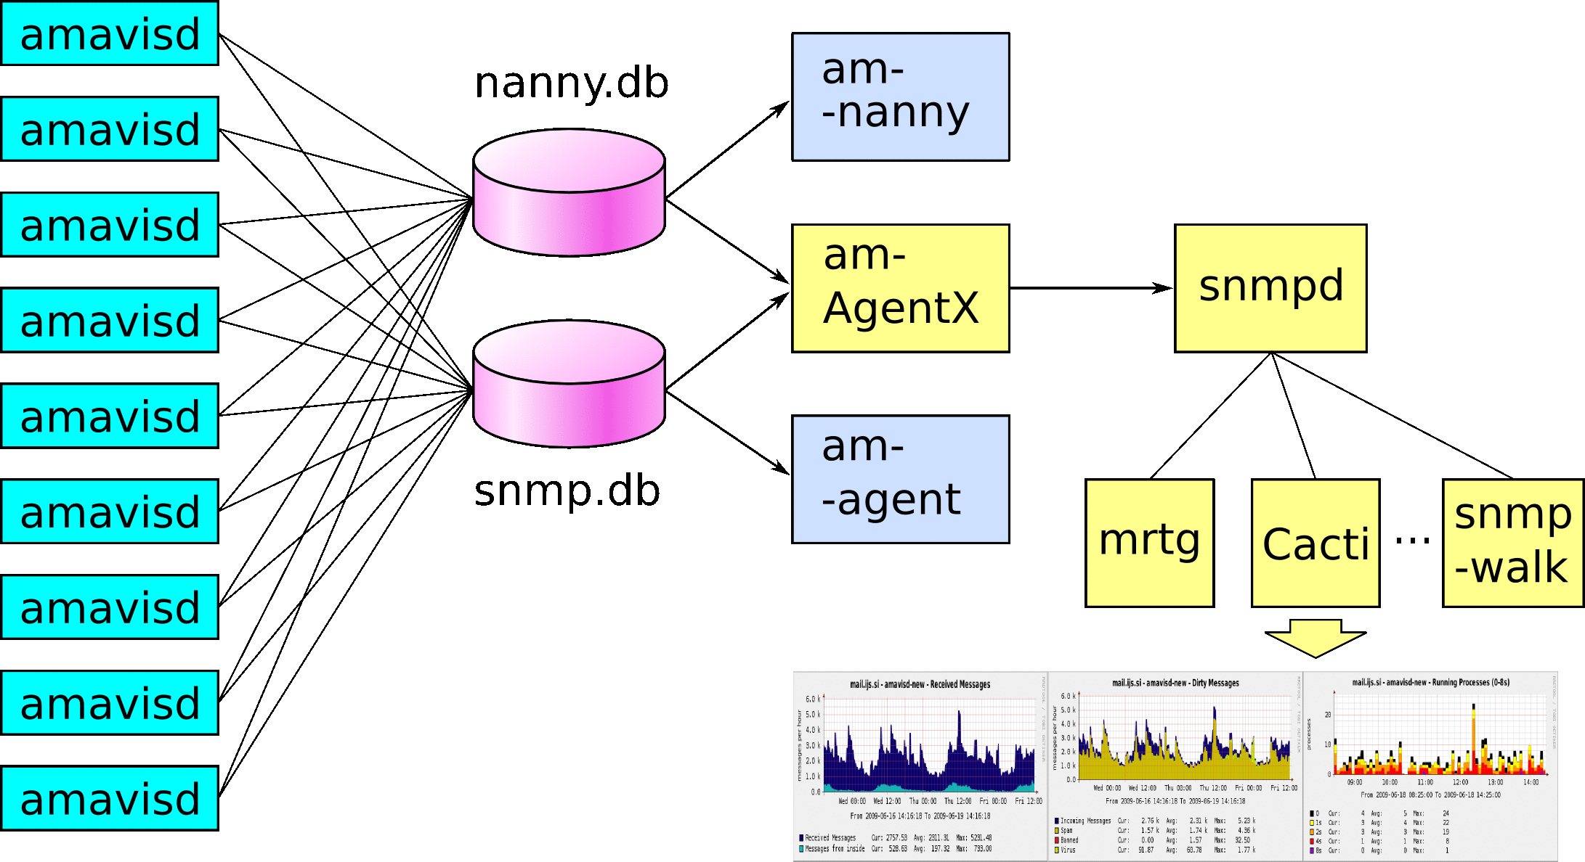
Monitoring – components
88

Slide 91
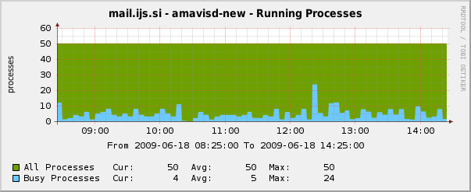
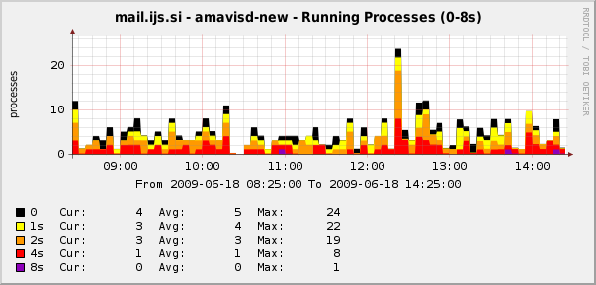
SNMP: load, timing
88

Slide 92
Statistics: amavisd-agent
sysUpTime (0 days, 14:03:43.46)
InMsgs 14490 1030/h 100.0 % (InMsgs)
InMsgsRecips 27169 1932/h 187.5 % (InMsgs)
ContentCleanMsgs 6020 428/h 41.5 % (InMsgs)
ContentSpamMsgs 7807 555/h 53.9 % (InMsgs)
ContentVirusMsgs 567 40/h 3.9 % (InMsgs)
ContentBadHdrMsgs 91 6/h 0.6 % (InMsgs)
ContentBannedMsgs 5 0/h 0.0 % (InMsgs)
92

Slide 93
Statistics: amavisd-agent
OpsSpamCheck 12719 904/h 87.8 % (InMsgs)
OpsVirusCheck 13231 941/h 91.3 % (InMsgs)
OpsSqlSelect 50680 3604/h 186.5 % (InMsgsRc)
OutMsgs 6248 444/h 100.0 % (OutMsgs)
OutMsgsDelivers 6248 444/h 100.0 % (OutMsgs)
OutForwMsgs 6155 438/h 98.5 % (OutMsgs)
OutDsnMsgs 35 2/h 0.6 % (OutMsgs)
OutDsnBannedMsgs 3 0/h 0.0 % (OutMsgs)
OutDsnSpamMsgs 32 2/h 0.5 % (OutMsgs)
92

Slide 94
Statistics: amavisd-agent
QuarMsgs 2704 192/h 100.0 % (QuarMsgs)
QuarSpamMsgs 2100 149/h 77.7 % (QuarMsgs)
QuarVirusMsgs 567 40/h 21.0 % (QuarMsgs)
QuarBannedMsgs 5 0/h 0.2 % (QuarMsgs)
QuarOther 32 2/h 1.2 % (QuarMsgs)
92

Slide 95
Statistics: amavisd-agent
W32/Netsky-P 191 14/h
W32/Mytob-CA 59 4/h
W32/Netsky-D 25 2/h
W32/Lovgate-V 21 1/h
W32/Netsky-Q 21 1/h
W32/Bagle-AG 17 1/h
HTML.Phishing.Pay-1 18 1/h
HTML.Phishing.Bank-1 12 1/h
W32/Mytob-Z 11 1/h
W32/Wurmark-J 11 1/h
W32/Lovgate-X 11 1/h
95

Slide 96
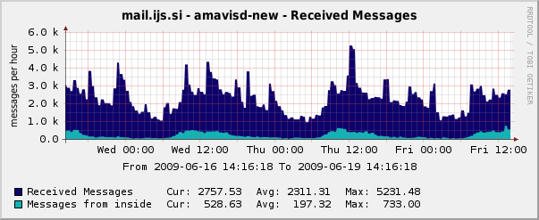
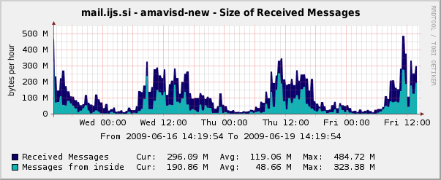
SNMP: mail rate, size
95

Slide 97
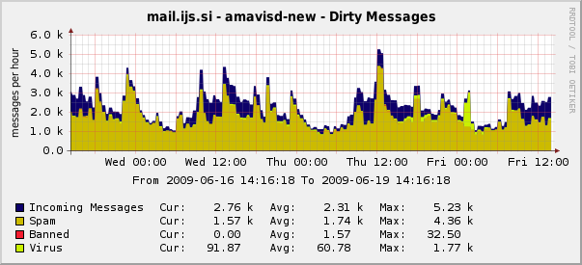
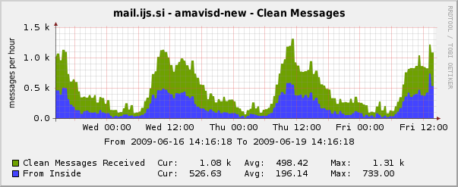
SNMP: mail content
<Foliennummer>

Slide 98
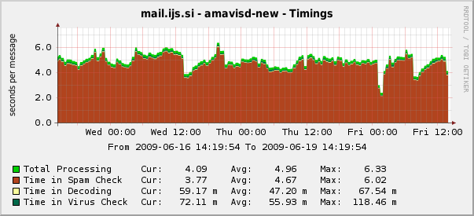
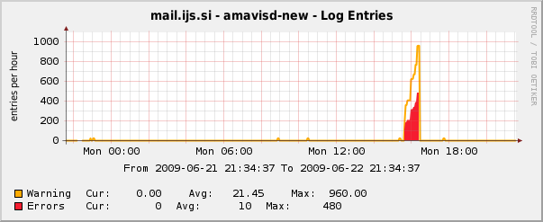
SNMP: elapsed time, errors
<Foliennummer>

Slide 99
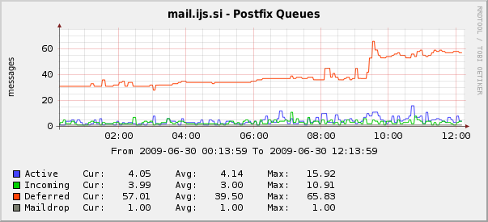
SNMP: Postfix queue entries
<Foliennummer>

Slide 100
Details in the log: timing report
TIMING [total 1725 ms] –
lookup_sql: 6 (0%)0,
SMTP pre-DATA-flush: 1 (0%)0, SMTP DATA: 88 (5%)6,
body_hash: 1 (0%)6, sql-enter: 4 (0%)6,
mime_decode: 6 (0%)6, get-file-type1: 23 (1%)7,
parts_decode: 0 (0%)8,
AV-scan-1: 7 (0%)8, AV-scan-2: 4 (0%)8, AV-scan-3: 5 (0%)8,
AV-scan-4: 1 (0%)9, AV-scan-5: 1 (0%)9, AV-scan-6: 0 (0%)9,
lookup_sql: 4 (0%)9, spam-wb-list: 3 (0%)9,
SA msg read: 0 (0%)9, SA parse: 2 (0%)9,
SA check: 1536 (89%)98,
update_cache: 2 (0%)98, post-do_spam: 6 (0%)99,
deal_with_mail_size: 0 (0%)99, main_log_entry: 18 (1%)100,
sql-update: 4 (0%)100, update_snmp: 1 (0%)100,
unlink-1-files: 1 (0%)100, rundown: 0 (0%)100
<Foliennummer>

Slide 101
Details in the log: SpamAssassin 3.3 timing
TIMING-SA total 3491 ms –
parse: 1.67 (0.0%), extract_message_metadata: 6 (0.2%),
get_uri_detail_list: 0.49 (0.0%), tests_pri_-1000: 13 (0.4%),
tests_pri_-950: 0.73 (0.0%), tests_pri_-900: 0.87 (0.0%),
tests_pri_-400: 16 (0.5%), check_bayes: 15 (0.4%),
tests_pri_0: 3106 (89.0%), check_dkim_adsp: 2 (0.1%),
check_spf: 5 (0.2%), poll_dns_idle: 0.25 (0.0%),
check_razor2: 1759 (50.4%), check_dcc: 1268 (36.3%),
tests_pri_500: 7 (0.2%), tests_pri_899: 77 (2.2%), check_crm114: 76 (2.2%), tests_pri_1000: 11 (0.3%),
total_awl: 10 (0.3%), check_awl: 3 (0.1%),
update_awl: 2 (0.1%), learn: 226 (6.5%),
crm114_autolearn: 201 (5.7%), get_report: 1.15 (0.0%)
<Foliennummer>

Slide 102
troubleshooting
amavisd-nanny
amavisd log and MTA log
increase log level if necessary
search log for am_id of a trouble message
strace -f amavisd foreground
<Foliennummer>

Slide 103
troubleshooting
# amavisd debug
# amavisd debug-sa
# amavisd foreground
selective debug: @debug_sender_maps
selective debug: dedicated policy bank with elev. log
compare output of 'amavisd debug-sa'
to 'su vscan -c spamassassin -t -D'
<Foliennummer>

Slide 104
Regular maintenance tasks
run amavisd-nanny or SNMP, note any
'process went away' reports, investigate
and fix the problem if any
check mailq or qshape for stalled messages
check for preserved directories
in /var/amavis/tmp, search log for
explanation, fix the problem and delete
remove old quarantine and SQL logs
<Foliennummer>

Slide 105
Questions?
mailing list
hang around and ask
...
<Foliennummer>

Slide 106
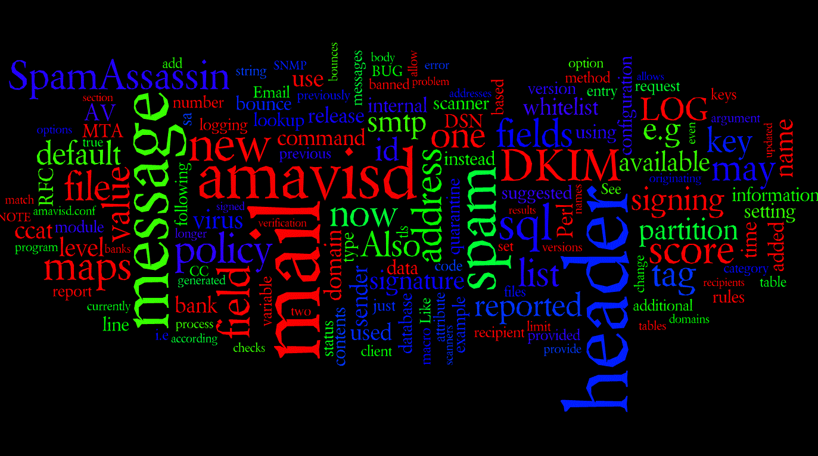
<Foliennummer>

